Slide 1

TATA Bank - Bank Management System
Group 29
Ashwini Yadav
Ruchitha S
Shivam Mishra
Jatin Rastogi
Mukhesh Sure
Dhanraj Shinde
1 | TCS confidential

Slide 2
Problem Statement
Managing financial operations efficiently is crucial for both banks and their customers. However, traditional bank management systems often lack seamless transaction tracking, real-time updates, and effective account management, leading to delays, errors, and customer dissatisfaction. The absence of a centralized platform for account management, transaction tracking, loan processing, and customer support further complicates operations. Additionally, inadequate customer service and limited accessibility to financial data hinder issue resolution and decision-making.
This application aims to provide an integrated bank management system that streamlines account management, real-time transaction tracking, loan processing,
2| TCS confidential

Slide 3
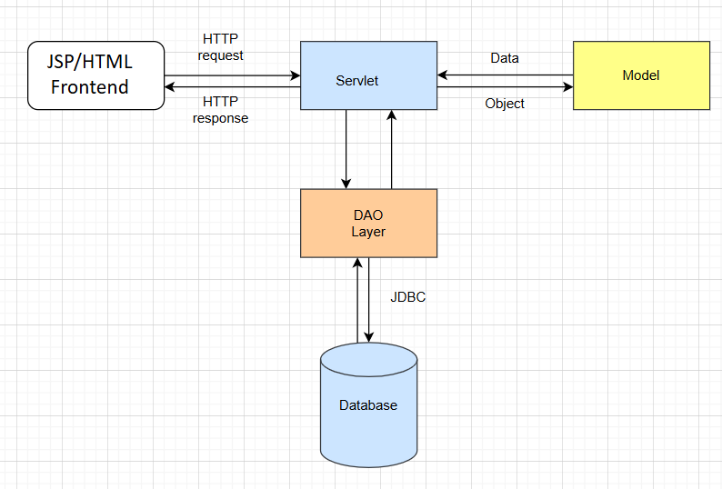
System Architecture
3 | TCS confidential

Slide 4




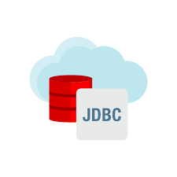


Technologies Used
4 | TCS confidential

Slide 5
User Stories
Landing Page
Three Login Forms:
Admin Login (Username & Password)
Employee Login (Employee ID & Password)
Customer Login (Customer ID & Password)
Sections:
Services: Overview of banking services.
About: Bank information and mission.
Home: Easy navigation back to the main page.
Designed for quick access and seamless user experience.
5 | TCS confidential

Slide 6
User Stories
2) Admin User Stories:
Admin Login:
As an admin, I want to log in using my username and password so that I can access the admin dashboard and manage the system.
Manage Employees:
As an admin, I want to add, update, or delete employee records so that I can manage the workforce efficiently.
6 | TCS confidential

Slide 7
User Stories
3) Employee User Stories:
Employee Login:
As an employee, I want to log in using my Employee ID and password so that I can access the employee dashboard and perform my duties.
Customer Account Management:
As an employee, I want to view and manage customer accounts so that I can assist customers with their banking needs.
7 | TCS confidential

Slide 8
User Stories
4) Customer User Stories:
Customer Login:
As a customer, I want to log in using my Customer ID and password so that I can access my account and manage my finances.
Account Overview:
As a customer, I want to view my account balance and transaction history so that I can keep track of my finances.
Transaction Management:
As a customer, I want to perform transactions such as transfers, deposits, and withdrawals so that I can manage my money efficiently.

Slide 9
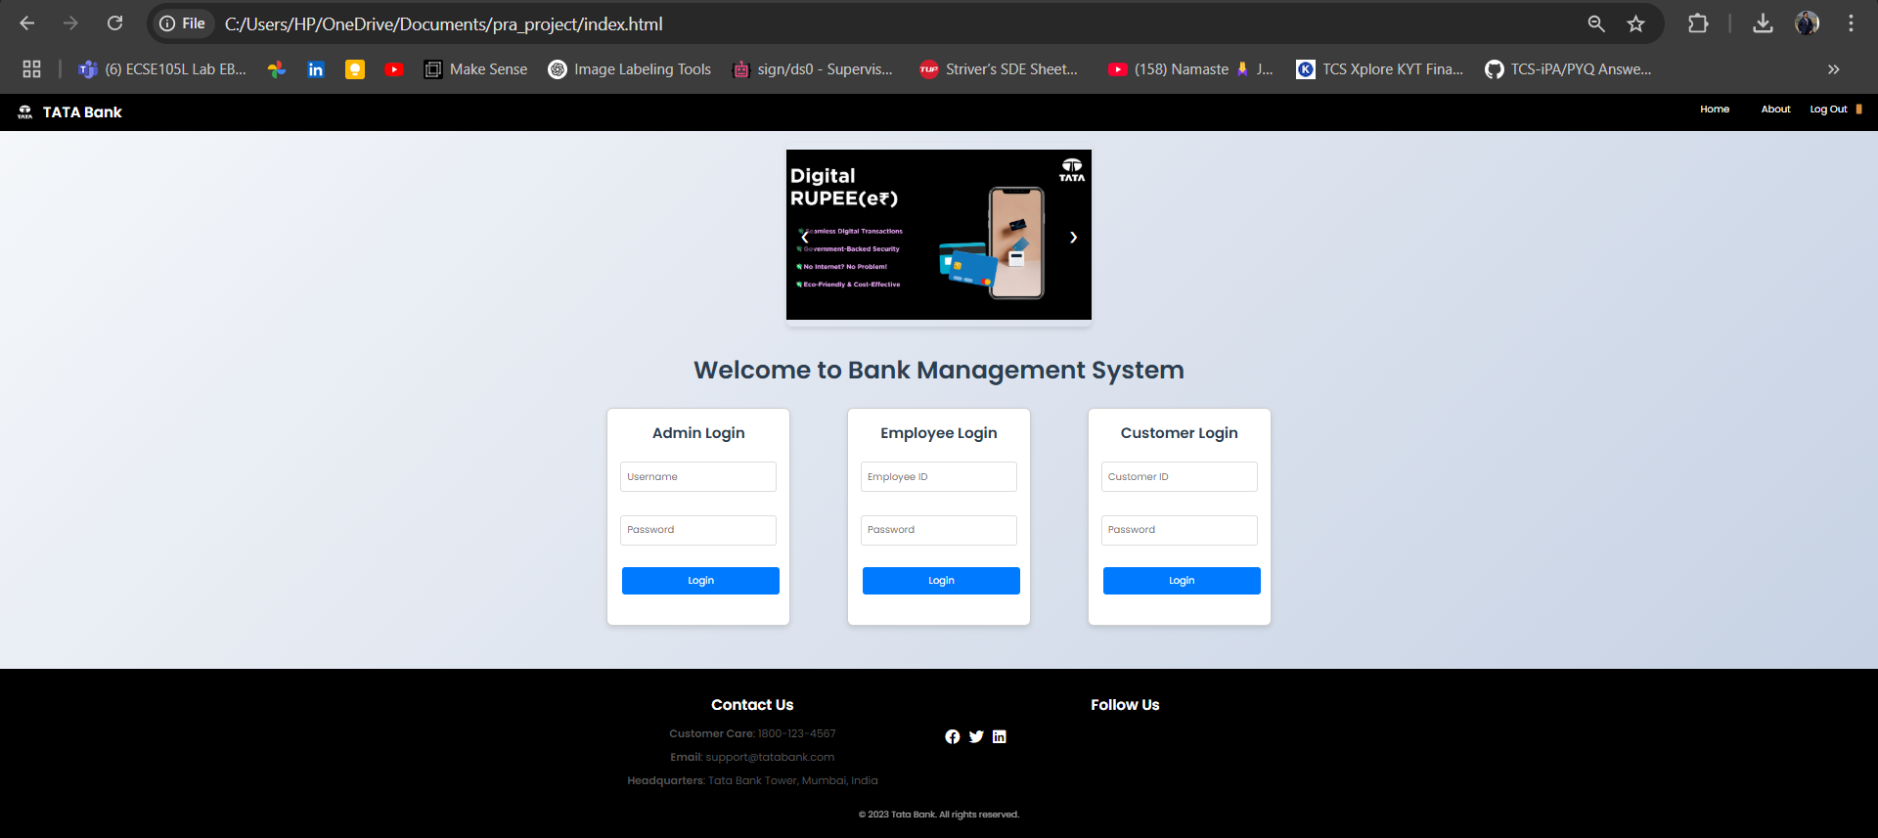
UI - Landing Page
8| TCS confidential

Slide 10
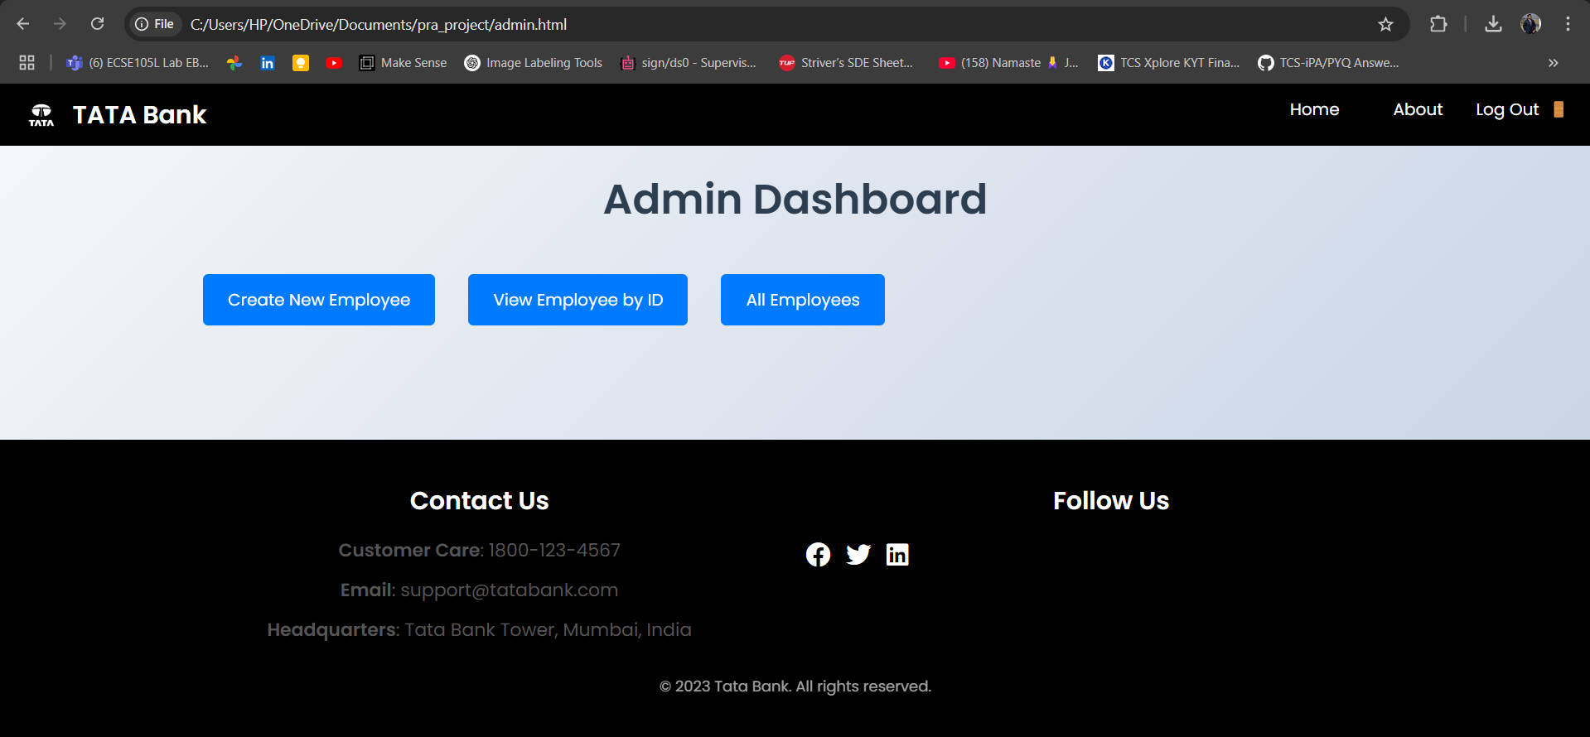
UI - Admin Dashboard
9 | TCS confidential

Slide 11
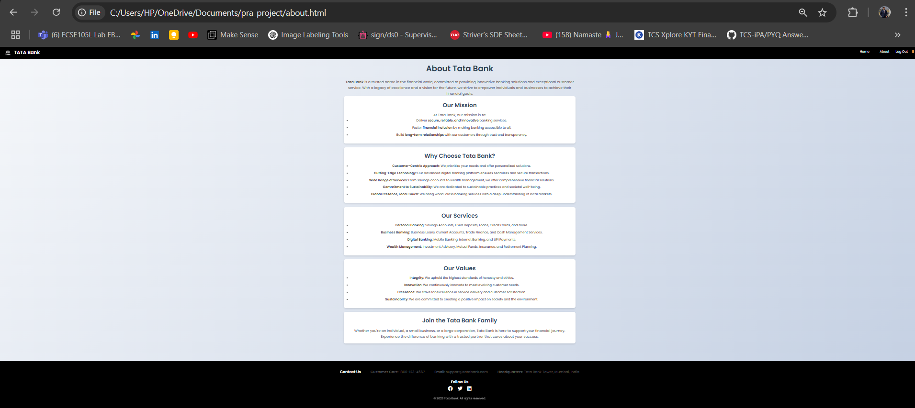
UI - About Page
12 | TCS confidential

Slide 12
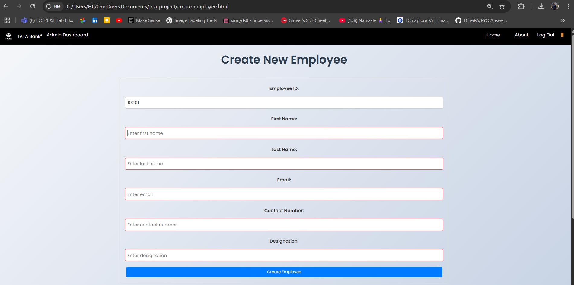
UI - Employee Registration Page
10| TCS confidential

Slide 13
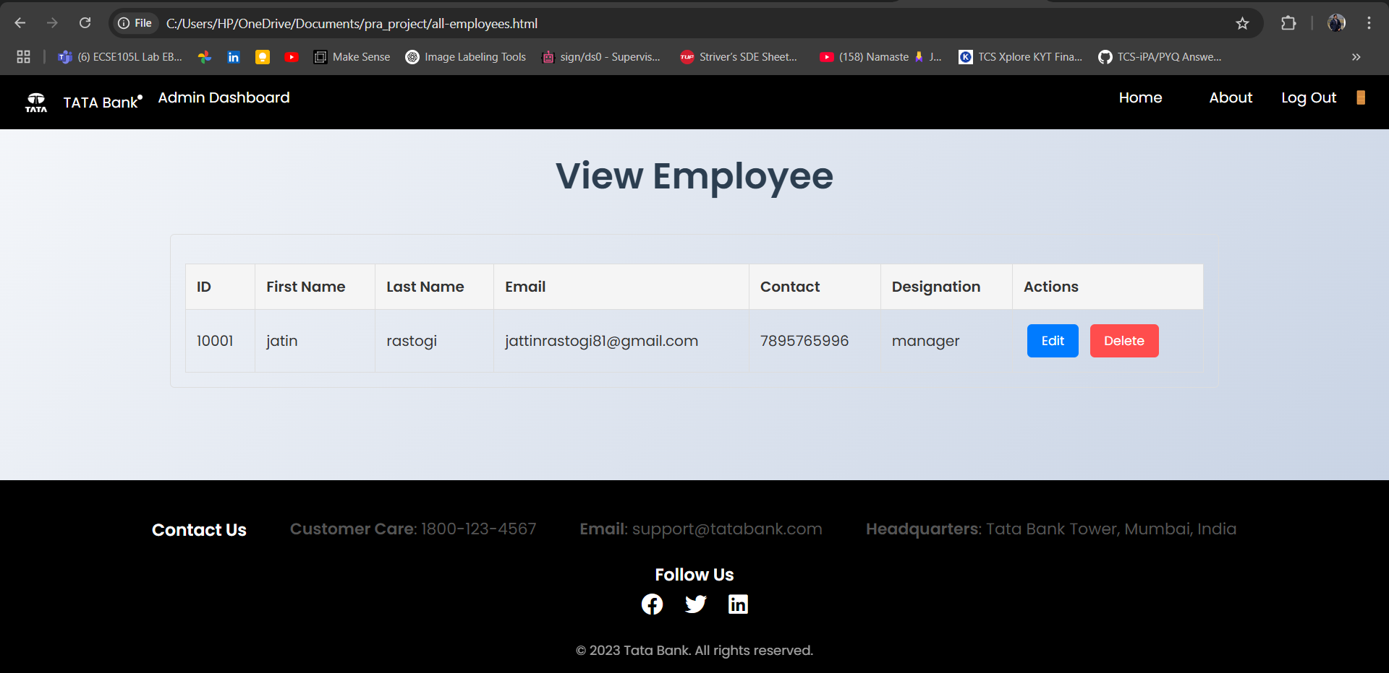
UI - Update Employee
1 1| TCS confidential

Slide 14
UI - Employee Dashboard
13 | TCS confidential

Slide 15
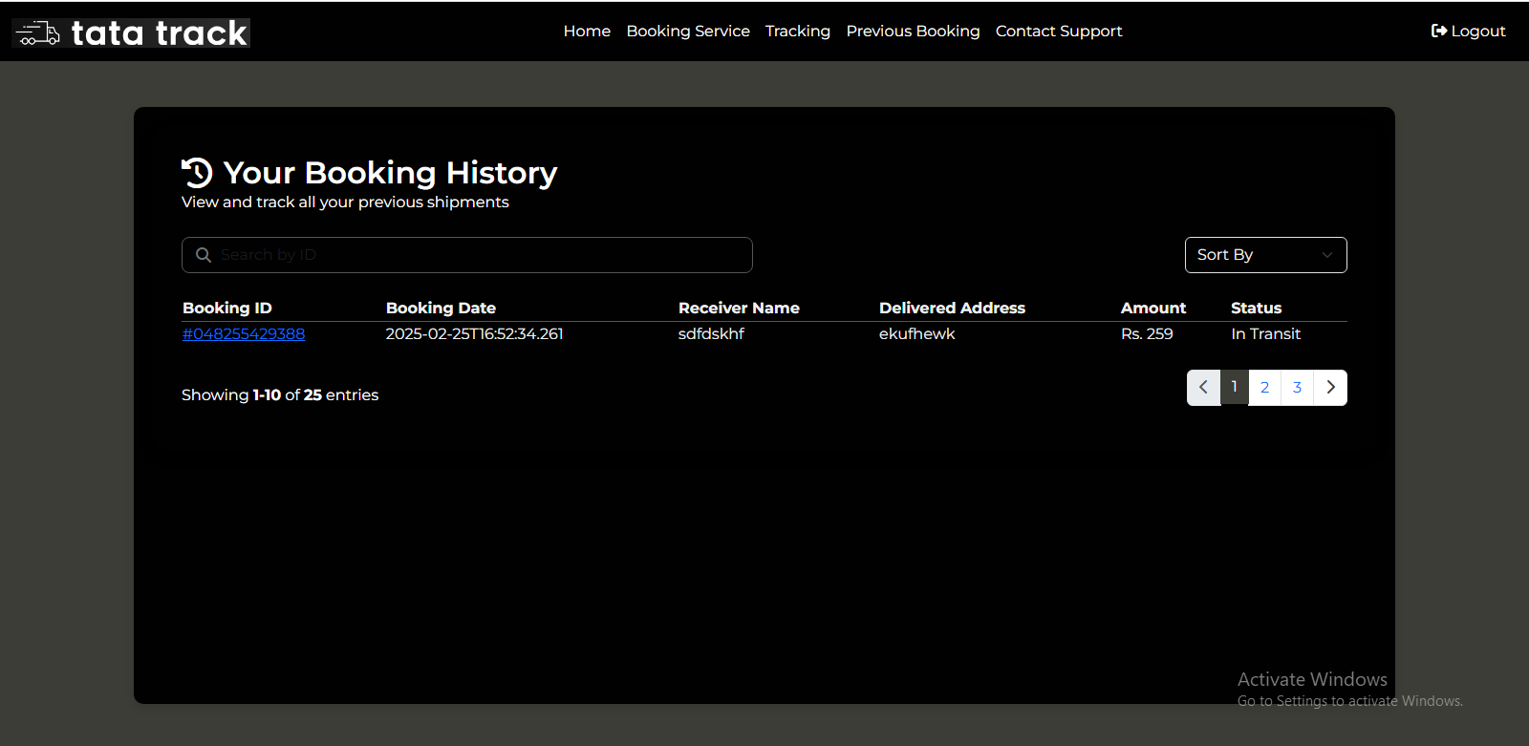
UI - Booking History
14 | TCS confidential

Slide 16
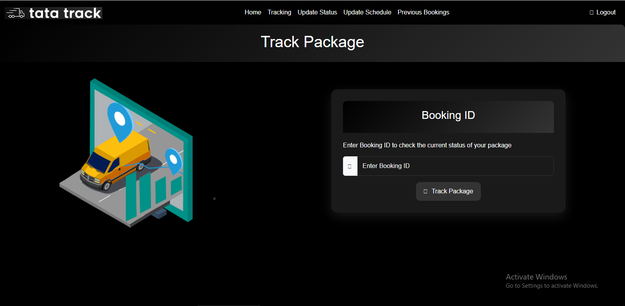
UI - Track Package
1 5| TCS confidential

Slide 17
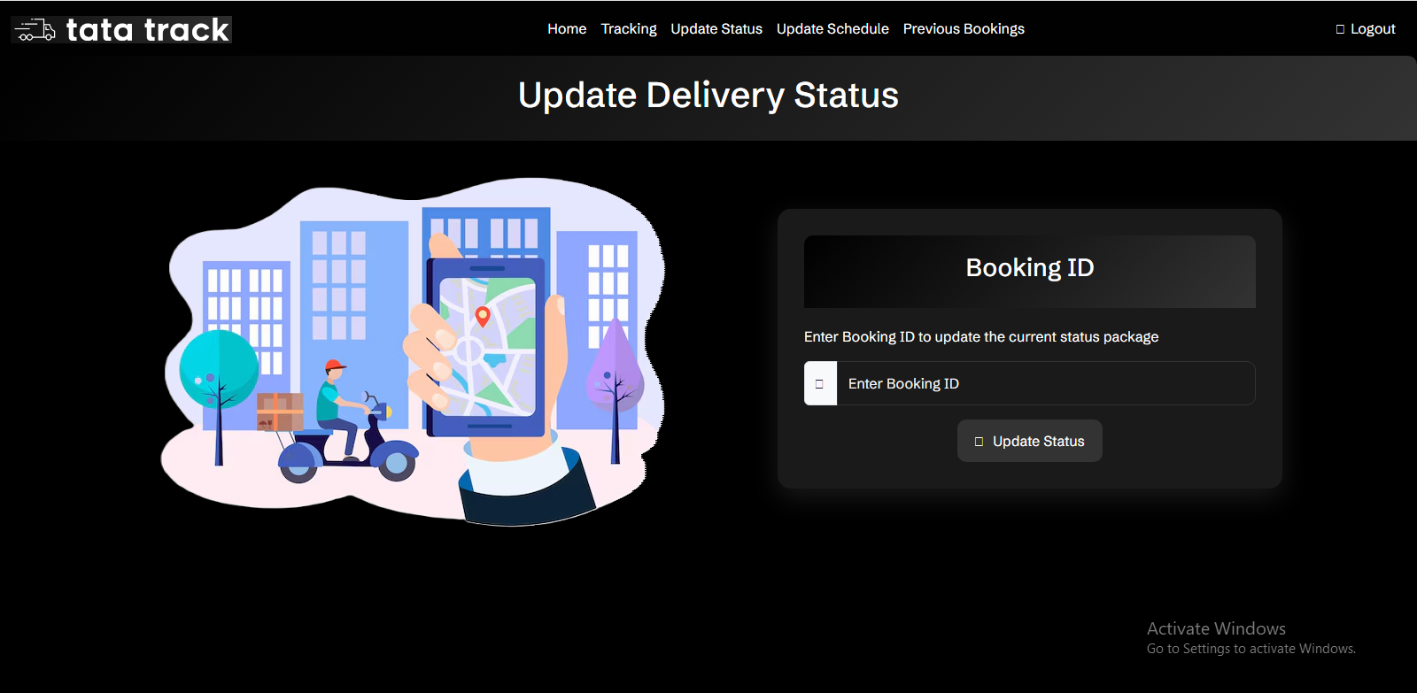
UI - Update Status
1 6| TCS confidential

Slide 18
Sprint Retrospective
Data Insertion
Insert sample data into Derby database using JDBC for admin, employee, customer, and transaction details.
Data Retrieval & User Interaction
Use JDBC for CRUD operations:
Admin: manage employees.
Employee manage customers.
Customer: View profile, update details (except balance), and perform transactions (transfer, deposit, withdraw).
20| TCS confidential

Slide 19
Sprint Retrospective
What Went Well:
Successfully created user, parcel, and booking tables efficiently.
Generated detailed reports for parcel delivery status.
Demonstrated strong team collaboration and effective task management.
Areas for Improvement & Action Items:
Implement Testing: Establish unit tests for database operations to ensure data accuracy and reliability.
Weekly Check-ins: Schedule regular progress updates to stay aligned with project goals and address challenges promptly.
21| TCS confidential

Slide 20
Future Goals
Enhance Security: Implement advanced authentication and encryption.
Mobile Integration: Develop a mobile app for on-the-go access.
AI & Analytics: Use AI for personalized services and predictive analytics.
Expand Services: Add investment and insurance management.
Global Access: Support multi-currency and international transactions.
Customer Experience: Improve UI/UX and 24/7 chatbot support.
22| TCS confidential

Slide 21
Thank You
23| TCS confidential

